Slide 1
Introduction to credit risk modelling
HSBC Quants Academy
Prepared by: Piotr Kobus, CFA, PRM
Date: 30/03/2026

Slide 2
Credit Risk – course module
Topics | Slide
Definitions | 03
Modelling landscape | 06
PD models | 08
LGD models | 11
EAD models | 14
Regulatory capital | 17
IFRS9 | 21
Stress testing | 23
Model validation | 26
Introduction to credit risk modelling
Risk-based pricing
Regression techniques and scorecard development

Slide 3
Definitions

Slide 4
Credit risk and default event
Credit risk - risk of financial loss due to counterparties not meeting their obligations in accordance with the agreed terms. Failure to fulfil an obligation is called a default. For example:
  Customers failing to make due payments on their products e.g. personal loans, mortgages, credit cards, overdrafts
  Bond issuers not making payments on a coupon or principal payment when due
  Consumers not paying trade invoices when due
  Counterparties to derivative transations not making due payments
Default - regulatory definition (CRR, Article 178)
„A default shall be considered to have occurred with regard to a particular obligor when either or both of the following have taken place:
  The institution considers that the obligor is unlikely to pay its credit obligations to the institution in full, without recourse by the institution to actions such as realising security e.g. credit obligation put on non-accrued status, adjustment resulting from a significant perceived decline in credit quality, sale of the credit obligation at a material economic loss, distressed restructure, bankruptcy
  The obligor is past due more than 90 days on any material credit obligation to the institution”

Slide 5
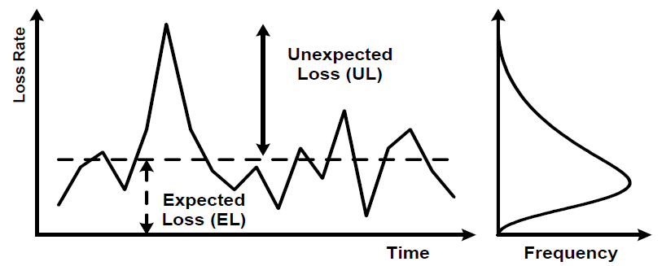
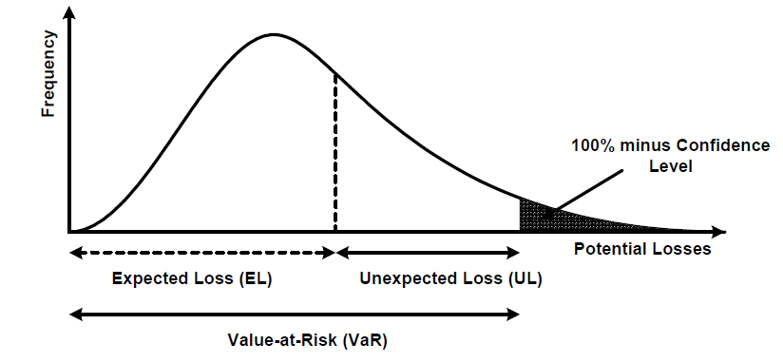
Expected and unexpected losses
Expected Losses (EL)
  Cost to run the business
  Managed by appropriate pricing and impairments (reserves)
Unexpected Losses (UL)
  Potential losses above the expected level
  Covered by capital (regulatory vs economic)
Source: Extracted from BCBS, "An Explanatory Note on the Basel II IRB Risk Weight Functions", July 2005

Slide 6
Modelling
landscape

Slide 7
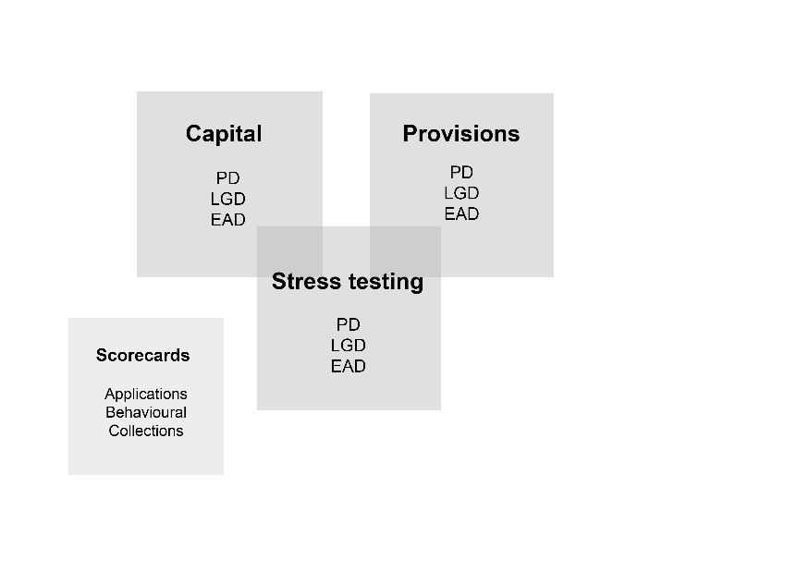
Credit risk models
Different risk metrics (PD, LGD, EAD) and use purposes (Capital, Provisions and Stress Testing).
Individual models range in complexity from sophisticated, data driven approaches to those based largely on expert judgement.
Usage of ML & AI techniques increases, however the classic techniques are still the most common in many modelling areas.
Typical software used for model development and validation: Python and R (previously SAS)
Model development and usage are subject to extensive external regulations and as well many internal policies and standards.
„... all models are approximations.
Essentially, all models are wrong, but some are useful.”*
  *George E. P. Box and Norman R. Draper, Empirical Model-Building and Response Surfaces, 1987

Slide 8
PD models

Slide 9
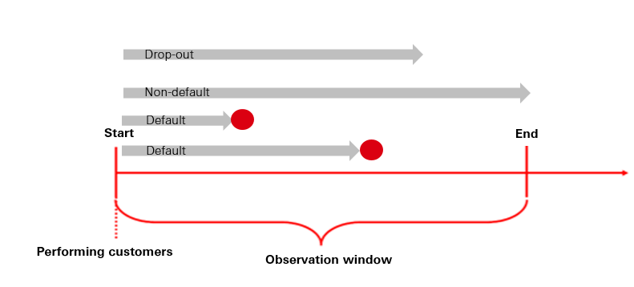
Probability of Default models
Problem - Banks lend money to customers e.g. term loans or overdraft facilities. Some customers might not be willing or able to pay back what they owe at some point in the future.
Question - What is a probability that a particular obligor doesn’t fullfil its obligations within the specific time horizon? What is an expected default rate in a particular porfolio?
Key concepts:
  Drop-outs
  Single period vs PD term structure
  PIT vs TTC estimates
  Conservative vs. unbiased estimates
Development approaches:
  Prediction of binary events (e.g. logistic regression, decision tree)
  Shadow rating approach (e.g. ordinal logistic regression)
  LDP methodologies
  Structural models (e.g. Moody’s CreditEdge)
  OLS on transformed default rates
  Transition matrices

Slide 10
Task 1
Based on the data in the Excel file, calculate portfolio default rate under the following approches:
  Including drop-outs
  Excluding drop-outs
  Time-weighed calculation

Slide 11
LGD models

Slide 12
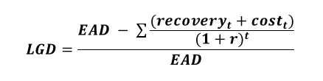
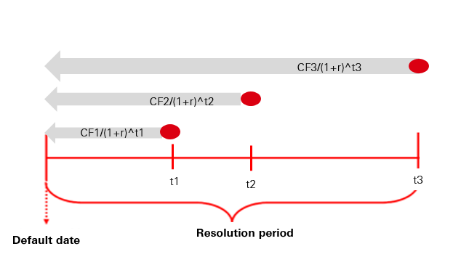
Loss Given Default models
Problem - If customers default, banks try to recover the money which they lent and the accrued interests. In the end there could be different outcomes i.e. cure, settlement, collateral reposession and sale or write-off.
Question - What is a fraction of exposure that bank won’t be able to recover in the event of default?
Key concepts:
  Nominal vs economical loss
  Default outcomes (cure, settlement, reposession and sale, write-off)
  Availability and type of collateral (secured vs unsecured)
  Loan to Value
  Seniority of the claim (e.g. senior debt, subordinated debt)
Development approaches:
  Component based – probability of individual outcomes and their associated losses
  Regression models e.g. Fractional logit, Tobit, Beta, Inflated Beta
  Decision trees

Slide 13
Task 2
Using the data in the Excel file, calculate nominal and economical LGD.

Slide 14
EAD models

Slide 15
Exposure at Default models
Problem - For non-revolving products (e.g. terms loans) balance amortises over time as a result of customers’ payments. Revolving products (e.g. overdrafts, credit cards) consists of a balance i.e. amount already drawn and a headroom (i.e. difference between the committed credit limit and its utilisation). The outstanding commitment can be drawn fully or partially before default.
Question - What’s the value of exposure which a bank could have at the moment of default?
Key concepts:
  Direct vs indirect estimation
  Cohort vs Fixed Period approach
Development approaches:
  Historical averages
  Decision Trees
  Linear Regressions
EAD - Balance _{observation point}
DDF =
Credit Limit - Balance _{observation point}
EAD - Balance _{observation point}
EADF =
Credit Limit
EAD
LEQ =
Credit Limit

Slide 16
Task 3
Using the data in the Excel file, calculate CCF and LEQ using a fixed horizon approach.

Slide 17
Regulatory capital

Slide 18
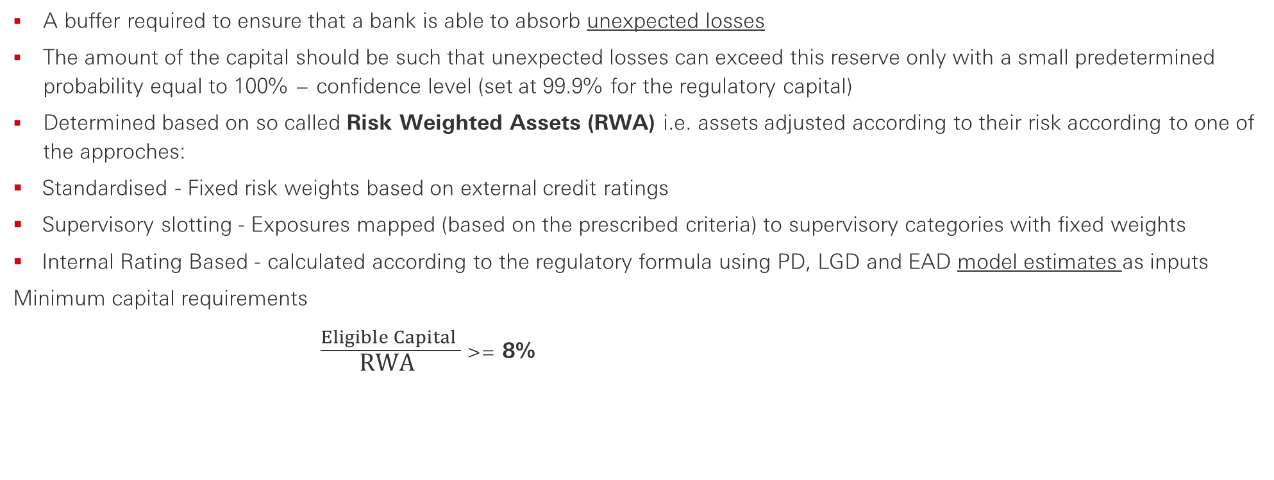
Capital
A buffer required to ensure that a bank is able to absorb unexpected losses
The amount of the capital should be such that unexpected losses can exceed this reserve only with a small predetermined probability equal to 100% − confidence level (set at 99.9% for the regulatory capital)
Determined based on so called Risk Weighted Assets (RWA) i.e. assets adjusted according to their risk according to one of the approches:
  Standardised - Fixed risk weights based on external credit ratings
  Supervisory slotting - Exposures mapped (based on the prescribed criteria) to supervisory categories with fixed weights
  Internal Rating Based - calculated according to the regulatory formula using PD, LGD and EAD model estimates as inputs
Minimum capital requirements
$\frac{Eligible Capital }{\text{RWA} }$ >= 8%

Slide 19
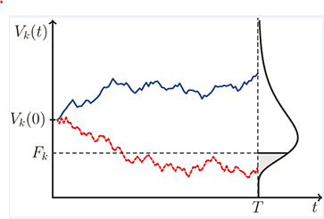
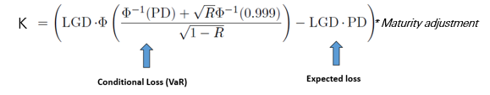
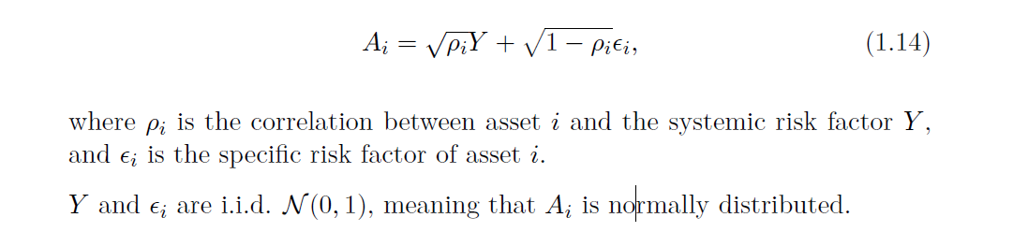


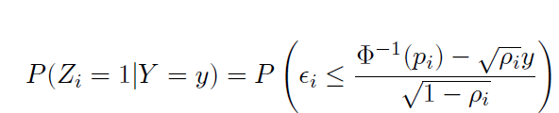
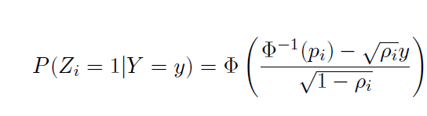
IRB risk weights formula
A(t)
Risk Weighted Assets (RWA) i.e. assets adjusted according to their risk
RWA = K * 12.5 * EAD
  PD - average probability of default that reflects expected default rates during normal business conditions.
  LGD - loss given default that reflects economic downturn conditions
  R - assets correlation parameter
Asymptotic Single Risk Factor model
Large number of relatively small exposures
Idiosyncratic risks tend to cancel out one-another
Systematic risks modelled with a single factor
Merton model - a default occurs when the value of firms assets falls below a ”default threshold”.
A(0)
D

Slide 20
Task 4
Based on the data in the Excel file, calculate capital requirements for individual customers in accordance with the IRB risk weight function, ignoring maturity adjustment and assuming asset correlation of 18%.
What’s the relationship between capital requirements and unconditional probability of default?

Slide 21
IFRS9

Slide 22
IFRS9 accounting standards
Aim to resolve the issue of the “too little, too late” recognition of credit losses by incorporating timely and forward-looking information.
An entity shall measure the loss allowance for a financial instrument based on expected credit losses (ECL) discounted to the reporting date.
ECL should be based on reasonable and supportable information about past events, current conditions and forecasts of future economic conditions that is available without undue cost or effort in projecting expected credit losses.
ECL should represent neither a best or worst-case scenario, but reflect the possibility that a credit loss occurs and vice versa
Stage 1 | Stage 2 | Stage 3
12-month Expected Credit Losses | Life-time Expected Credit Losses | Life-Time Expected Credit Losses
ECL recognised in profit/loss as soon as a financial instrument is originated or purchased | Credit risk increases significantly but not impaired. Rebuttable presumption that 30 days past due indicates a sign of significant increase of risk. | Credit-impaired financial assets through objective evidence

Slide 23
Stress testing

Slide 24
Stress testing
A method of identifying and assessing vulnerabilities. Stress tests examine the potential impact of hypothetical adverse scenarios on banks capital adequacy i.e. does bank have enough capital to withstand shocks if a particular stress does materialise
Given the mechanics of the IRB risk weight function, capital requirements are pro-cyclical i.e. increase during an economic downturn whereas capital resources are squeezed at the same time, through lower income and higher losses.
Modelling effects of an adverse scenario on all elements of the balance sheet (capital resources, RWA, impairment charges) allows bank’s management and regulators and to determibe necessary capital buffer.
Modelling typically involves time series regressions with segment / portfolio level target variable and transformed macroeconomic variables as predictors
Assumption of perfect-foresight
Different forecast horizons and granularity of regional regulatory stress testing exercises

Slide 25
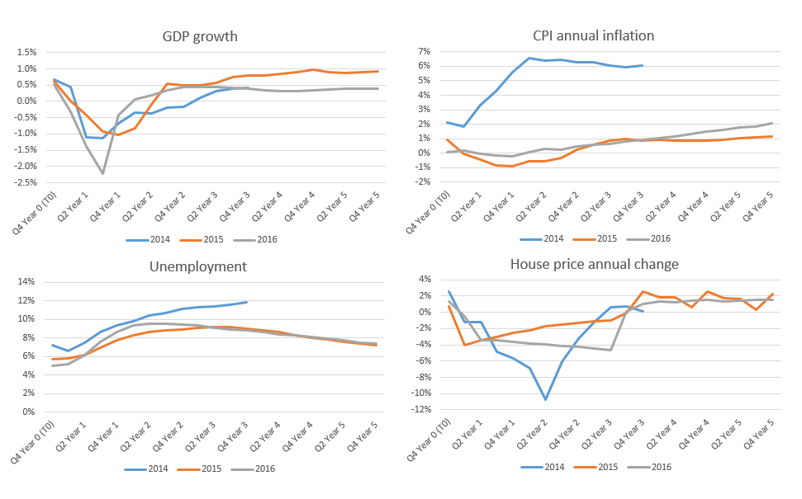
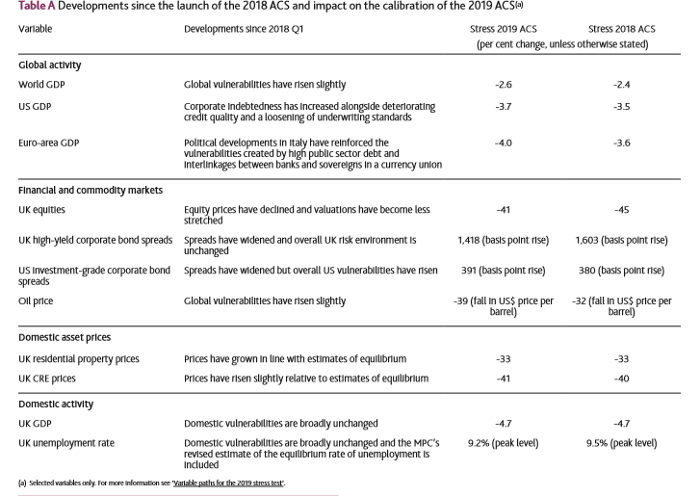
Examples of PRA Scenarios
Source: Bank of England, Stress testing the UK banking system: key elements of the 2019 annual cyclical scenario

Slide 26
Model validation

Slide 27
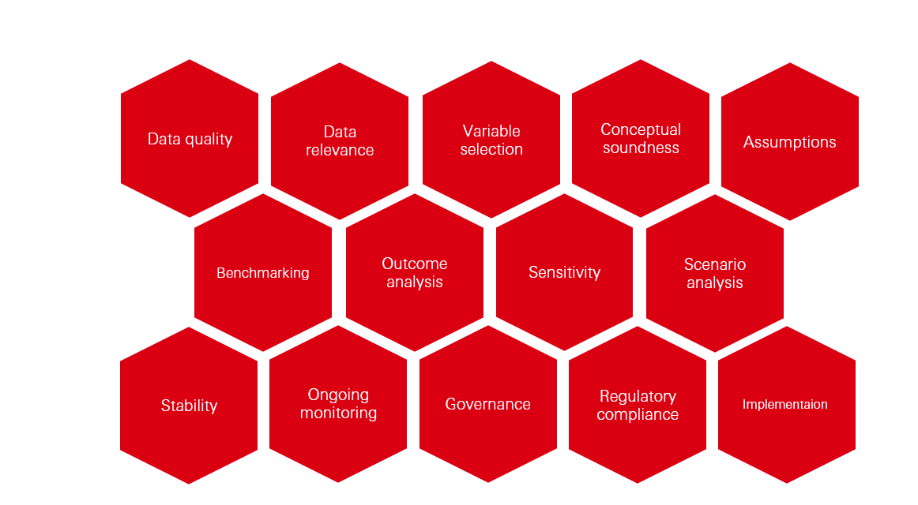
Model validation

Slide 28
Disclaimer
This presentation has been prepared by HSBC Service Delivery (Polska) Sp. z o.o. with a registered office located at Kapelanka 42A,
30-347 Kraków, Poland, registered in the District Court for Kraków-Śródmieście in Kraków, XI Commercial Division of the National Court Register, under the number KRS 0000310459, share capital (entirely paid) in the amount of 67 689 500,00 PLN, NIP 525-242-91-07, hereinafter referred to as “HSBC”.
HSBC has based this document on information obtained from sources it believes to be reliable but which has not been independently
verified. While this information has been prepared in good faith, no representation or warranty, express or implied, is or will be made
and no responsibility or liability is or will be accepted by the HSBC, or by any of their respective officers, employees or agents in relation
to the accuracy or completeness of the Documents or any other written or oral information made available to any interested party or its advisers and any such liability is expressly disclaimed. Any charts and graphs included are from publicly available sources or proprietary
data. No liability is accepted whatsoever for any direct, indirect or consequential loss arising from the use of this document. HSBC is under
no obligation to keep current the information in this document. You are solely responsible for making your own independent appraisal of
and investigations into the data, products, financial instruments and transactions referred to in this document and you should not rely on
any information in this document as constituting investment advice. Neither HSBC nor any of its affiliates are responsible for providing you with legal, tax or other specialist advice and you should make your own arrangements in respect of this accordingly. The issuance of and details contained in this document, which is not for public circulation, does not constitute an offer or solicitation for, or advice that you
should enter into, the purchase or sale of any security, commodity or other financial instrument or master agreement, or any other contract, agreement or structure whatsoever. This document is intended to be distributed in its entirety. Reproduction of this document, in whole or in part, or disclosure of any of its contents, without prior consent of HSBC or any associate, is prohibited.

Slide 29
Thank you!

